Slide 1

13
CHAPTER
PROGRAMMING AND LANGUAGES
Notes:
This chapter discusses the steps in the programming process (similar to systems analysis and design) and programming languages available – from machine to “natural” language
Programming is part of Step 4 where you actually develop (or write) a new system
Computer competent users need to be aware of the six steps of programming:
Program specification
Program design
Program code
Program test
Program documentation
Program maintenance

Slide 2

Learning Objectives
Define programming and describe the six steps of programming.
Compare design tools including top-down design, pseudocode, flowcharts, and logic structures.
Describe program testing and the tools for finding and removing errors.
Describe CASE tools and object-oriented software development.
Explain the five generations of programming languages.

Slide 3

Introduction
In this chapter, you focus on Phase 4, Systems Development, of the systems life cycle and learn about the programming process and some of the programming languages that are available
Competent end users need to
understand the relationship
between systems development
and programming

Slide 4
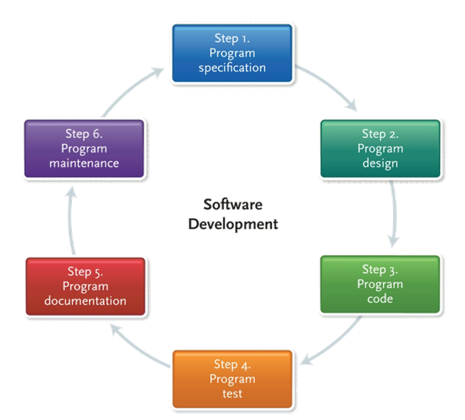
Programs and Programming
Program
A problem-solving procedure
A list of instructions for the computer to follow to accomplish a task of processing data into information.
  Prewritten/packaged
  Custom-made
Programming
Software Development
Software Development Life Cycle(SDLC)
Software Development Life Cycle
Notes:
A program (key term) is a list of instructions for the computer to follow to accomplish the task of processing data into information
Programming (key term) also known as software development (key term) or the software development life cycle (SDLC) (key term)
When writing a program from scratch, the programmer (key term) or software engineers (key term) generally follows these six steps to obtain an end product that will solve your computing needs.
The specifications are the objectives (Key Term), the output, the input, and the processing requirements that are determined by you and the programmer.
The design is the creation of the solution using a variety of techniques (generally including pseudocode, flowcharts, and logic structures.
The program code is written
Testing code or debugging to get rid of syntax and/or logic errors.
The program is documented as it is written. Sometimes this is done within the code itself (as with some Web languages where you can insert explanations without this information showing on the page); other times the documentation is done in a “manual” that will help others see where you have been/gone/or how you got where you did with your coding.
Program maintenance – As with system analysis and design, an on-going part of every software development is the maintenance – checking to be sure the program is doing what it is supposed to do and that the objectives have not changed.
In organizations, computer professionals known as software engineers (Key Term) or programmers (key term) use this six-step procedure

Slide 5
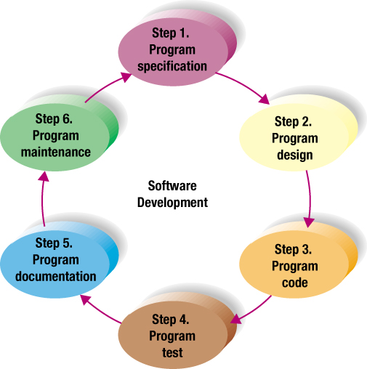
What is Programming?
14-<number>
Programming is software development
Six step procedure
  Program specification
  Program design
  Program code
  Program test
  Program documentation
  Program maintenance
Notes:
When writing a program from scratch, the programmer generally follows these six steps to get to the end product that will solve your computing needs. The specifications are the objectives, the output, the input, and the processing requirements that are determined by you and the programmer.
The design is the creation of the solution using variety of techniques (generally including pseudocode, flowcharts, and logic structures). After the code is written, it is tested or debugged to get rid of syntax and/or logic errors.
The program is documented as it is written. Sometimes this is done within the code itself (as with some Web languages where you can insert explanations without this information showing on the page); other times the documentation is done in a “manual” that will help others see where you have been/gone/or how you got where you did with your coding.
As with system analysis and design, an on-going part of every software development is the maintenance – checking to be sure the program is doing what it is supposed to do and that the objectives have not changed.

Slide 6
Self-Test
14-<number>
Program
Spec
A. Write procedures for user, operators and programmer
Program
Design
B. Ajustment for errors, inefficient or ineffective operations,
non-standard code, changes over time
Program
Code
C. Use structured processing technologies
Program
Test
D. Determining the objective, output, input, requirements
Program
Documentation
E. Select programming language, write the programs
Program
Maintenance
F. Perform desk check, manual check,
test using sample data, beta test with protential users

Slide 7
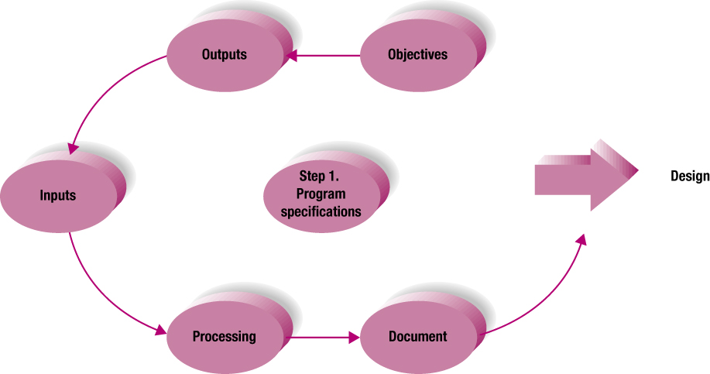
Step 1
Program Specifications
14-<number>
Also called program definition or program analysis
Five steps to complete in the process
Notes:
The first step in writing software (programs) is to establish what results you want – in other words, what do you want the software to accomplish? Therefore, establishing your “output” helps you get to your input and what you need to do to get to your output. Usually the input process steps and the processing requirements fall into place once you establish your output – where you want to go.
BE SURE TO DOCUMENT WHAT YOU ARE DOING, WHY, HOW, AND WHAT YOU DID TO GET TO WHERE YOU ARE AT THIS POINT!

Slide 8
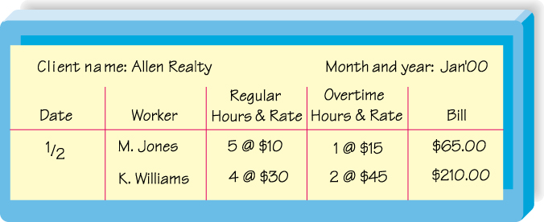
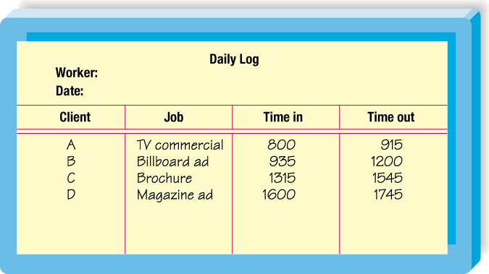
Input and Output Plans
14-<number>
Program objectives
Desired output
Input data
Processing requirements
Program specifications document
Notes:
Have program objectives
What problems are you trying to solve?
Specify your inputs before your outputs
Have a list of what you want to get out of the system
The end-user (not the programmer) should sketch what is needed
Input data
Determine the source of the data
What are the processing requirements?
Tasks to move input to output
Document program specifications
This is an essential step and is often left out

Slide 9
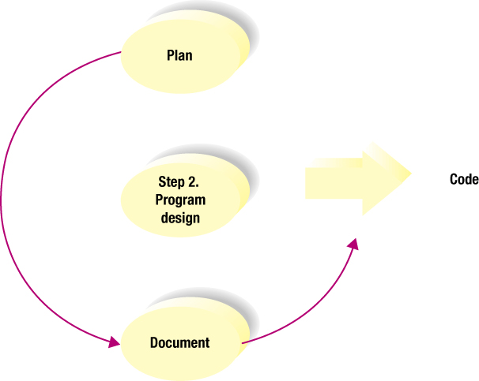

Step 2
Program Design
14-<number>
Plan a solution
Use structured programming techniques
  Top-down program design
  Pseudocode
  Flowcharts
  Logic structures
Notes:
In this step, the solution is created using program techniques such as those mentioned here. Probably the two most functional are pseudocode and flowcharts. Pseudocode is an outline (in English) of the logic (route) the program will take. Be specific on this part. The rest will be easier!
Flowcharts have been used for years and give a picture of what your pseudocode will look like (what your logic will be). Flowcharts help you “see” where you are going and determine if this, then that; if not, then this.
Use your flowcharts and your pseudocode as part of your documentation – to help others understand your logic as most people don’t follow the same path to get to the end.
Talk about logic structures here – if then else; loop structures (do until and do while). If a person looks at a problem, the automatically solve the problem by subconsciously saying “if I do this, then this will happen; if I do that, then (else) that will happen.” Computers do the same type of logic – except they have to be instructed to do this kind of thinking – i.e. the logic structure and the loop.

Slide 10
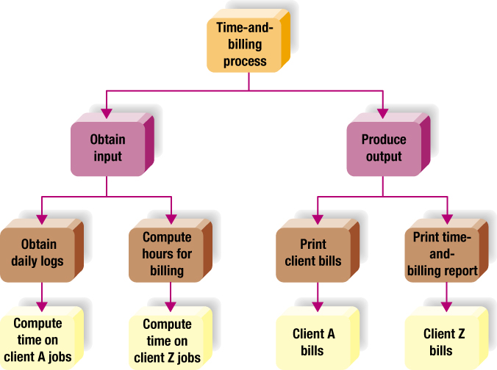
Top-Down Program Design
14-<number>
Notes:
First determine the outputs and the inputs of the program
Use top-down-program design to identify the program’s processing steps
Each step is called a module
Each module is made up of logically related program statements
Each module should have a single function
The program must pass in sequence from one module to the next until all modules have been processed by the computer
Review the above example with the students
It is for a time-and-billing report program

Slide 11
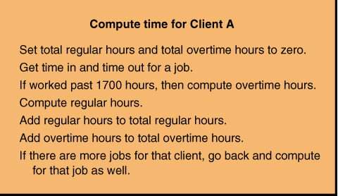
Pseudocode
14-<number>
An outline of the logic for your program
A summary of the program
Notes:
This is an outline of the logic of the program
It is written in simple English
It is like doing a summary of the program before you write it

Slide 12
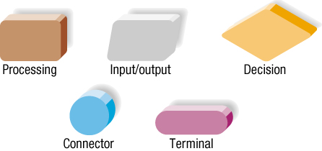
Flowchart Symbols
14-<number>
Graphically present the detailed sequence of steps needed to solve a programming problem
Notes:
These symbols are used to present the sequence of steps needed to solve a programming problem
Keep in mind that a computer performs instructions in steps
It does more than arithmetic; it makes comparisons
The above symbols can be used to answer the question - “Compute time on Client A jobs” in a top-down program design

Slide 13
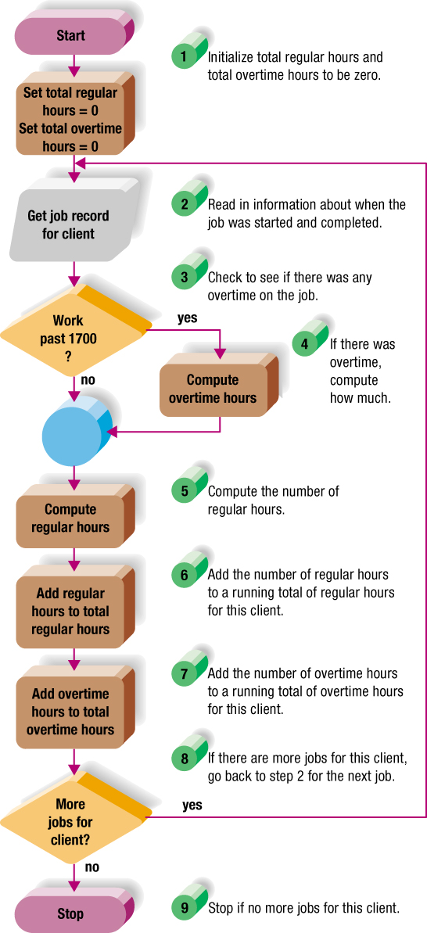
14-<number>

Slide 14
Logic Structures
14-<number>
Sequence structure
Selection structure
Loop structure
Notes:
You can link various parts of the flowchart with logic structures
There are three – sequence, selection, and loop
Sequence – one program statement follows another
Selection – occurs when a decision needs to be made
Loop – describes a repeated process
Variations include..
DO UNTIL
DO WHILE

Slide 15
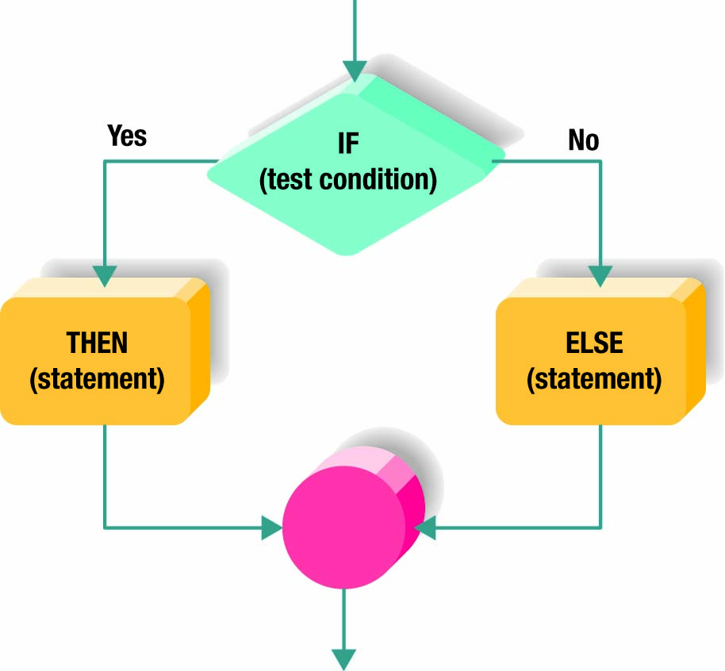
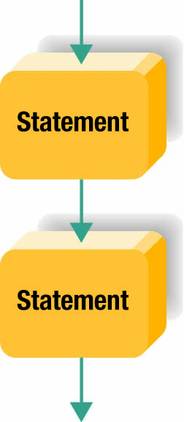
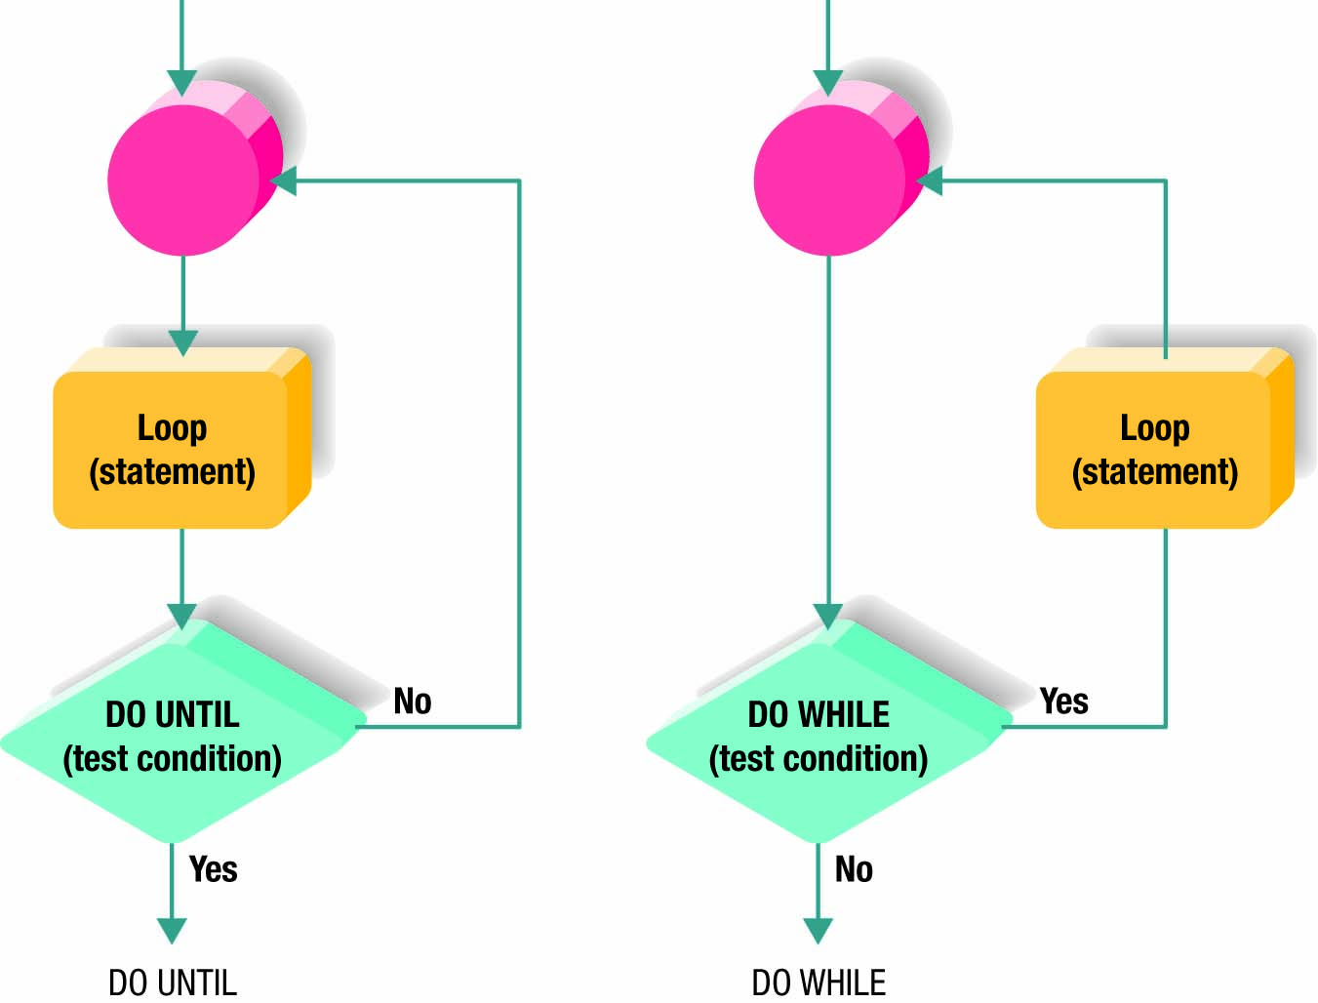
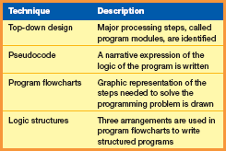

Logic Structures
14-<number>
Page 404
Notes:
Talk about logic structures here – sequence, if-then-else (Key Term); loop structures (do until (Key Term) and do while (Key Term)). If a person looks at a problem, then automatically solves the problem by subconsciously saying “if I do this, then this will happen; if I do that, then (else) that will happen.” Computers do the same type of logic – except they have to be instructed to do this kind of thinking – i.e. the logic structure and the loop.
You can link various parts of the flowchart with logic structures
There are three – sequence, selection, and loop
Sequence – one program statement follows another
Selection – occurs when a decision needs to be made; IF-THEN-ELSE
Loop – describes a repeated process
Variations include
DO UNTIL
DO WHILE

Slide 16
Do until & Do while
14-<number>
1
Do x=x+1, y=y-1
While y>=1
X=0
Y=2
2
While y>=1
do x=x+1, y=y-1

Slide 17
practice
14-<number>
Objective:著名的素数问题
  将1到1000之间的素数打印出来

Slide 18
埃拉托色尼筛法
14-<number>
1
2
3
4
5
6
7
8
9
10
11
12
13
14
15
16
17
18
19
20
21
22
23
24
25
26
27
28
29
30
31
32
33
34
35
36
37
38
39

Slide 19
Top-down design
14-<number>
用筛法求素数
输入1~n数字
所有非素
数去掉
打印全部素数

Slide 20
14-<number>
所有非素
数去掉
先去掉1
去掉2的
倍数
去掉3的
倍数
去掉n的
倍数
根据数学原理:求1~n之间的素数,
只需要进行到去掉n的开平方后整数即可

Slide 21
Pseudocode
14-<number>
去掉1;
用下一个未被挖去的数p去除p后面的各数,把p的倍数挖掉
检查p是否小于”n的平方根整数”(如果n=1000,则检查p<31),如果是则返回2继续执行,否则结束
纸上剩下的数就是素数

Slide 22
Using logic structures
14-<number>
A
D
输入n
1=> i
While(i<=n)
{
i=>x[i];
i+1=>i;
}
输入1~n
B
把所有非
素数去掉
E
C
打印全部素数
J

Slide 23
14-<number>
E
将x[i]去掉(让x[i]=0)
2=> i
While(i<n)
{
如果x[i]未被去掉,则将x[i+1]到
x[n]之间全部x[i]倍数去掉;
i+1=>i;
}
F

Slide 24
14-<number>
F
If(xi=0)
{
将xi+1到xn是xi倍数的数去掉;
}
G
G
i+1=i;
While(j<=n)
{
能被xi整除的xj去掉;
j+1=>j;
}
h

Slide 25
14-<number>
h
If(xi=0)
{
if(xj能够被xi整除)xi=0;
}
I
I
xj/xi的余数=r;(mod运算)
If(r=0)xi=0;

Slide 26
14-<number>
J
1=>i;
While(i<=n)
{
把未挖掉的xi打印出来;
i+1=>i;
}
k
k
If(xi<>0)
{
打印xi;
}

Slide 27
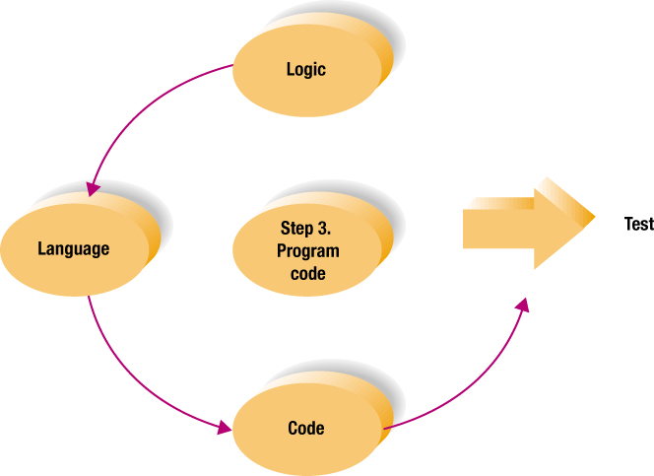
Step 3
Program Code
14-<number>
Coding： Writing the program
The good program
  Reliable
  Well documented
  Understandable to other programmers
  Structured programs best method
Notes:
This is the easiest part where you actually write or key into the computer the instructions the program is to follow
Just be sure that your code is reliable – works under most conditions!
Use the most appropriate language (C++, Visual BASIC, Java) for the situation for which the code will be used. If you’re writing a program for Internet use, probably VB or Java or one of the other “newer” languages (or scripts)
Again– document what you are doing and why so when you review later or someone else needs access to your code you will know why you did what you did the way you did it!

Slide 28
Coding
14-<number>
Programming
language
Formatting
language
C
C#
html
XML
C++
Java
DHTML
XHTML
Visual Basic
WML

Slide 29

Step 4
Program Test
14-<number>
Debugging
  Testing
  Eliminating errors
Syntax errors
Logic errors
Testing processing
Notes:
Now it’s written, so let’s test your program to be sure it does what you intended. This procedure sometimes is called “Debugging” -- testing a program and correcting syntax and logic errors.
Syntax errors - violation of the programming language rules
Logic errors - result of omitted programming procedure or incorrect calculation
Testing process involves one or more of several methods:
Desk checking - printout of program reviewed line by line
Manual testing with sample data - correct and incorrect data manually entered, results evaluated
Attempt at translation - written program goes through translator program on the computer, must be syntax error free
Testing sample data on the computer - tests for logic errors
Beta testing: testing by a select group of potential users; users provide feedback

Slide 30
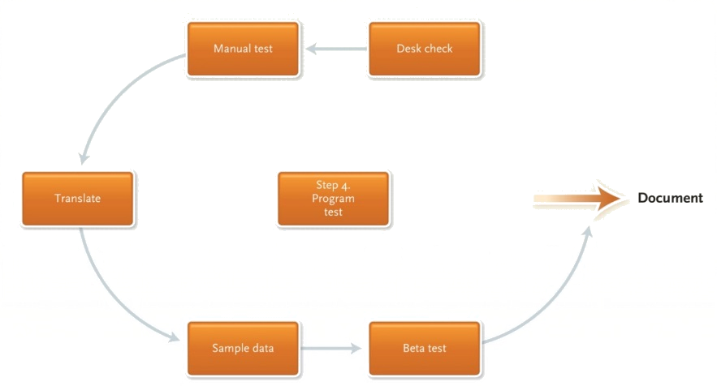
Testing Process
14-<number>
Desk checking
Manually testing
translation
Sample data
testing
Testing by
potential users

Slide 31
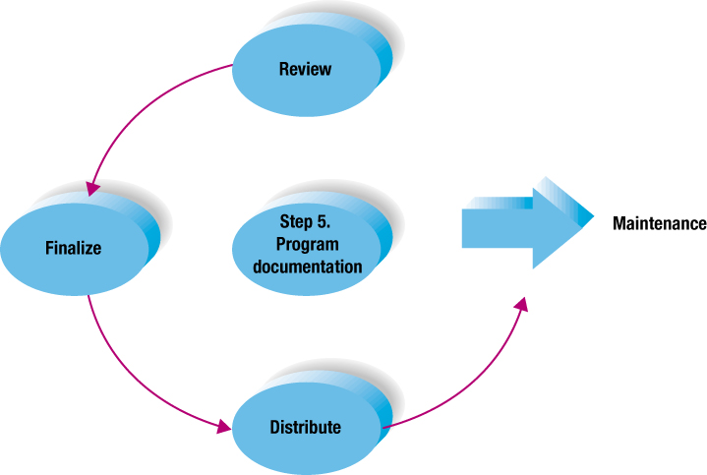
Step 5
Documentation
14-<number>
Written descriptions and procedures about a program
Important for people who will use the program
  Users
  Operators
  Programmers
Notes:
“Documenting” means writing a description of the purpose and process of the program.
Not an afterthought at the end of the programming process, but prepared throughout the programming steps
Documentation very important to
Users - needing to know how to use the software; hardest part is to get documentation in “language” most lay people can understand. If you build something, you know what to expect; if someone else builds it, you may not understand why they did what they did.
Operators - for dealing effectively with error codes and other problems
Programmers - for updates and modifications; even programmers tend to forget how they came up with the “logic” of the program; documentation helps reconstruct the thought process and reasoning behind the code sequence.

Slide 32
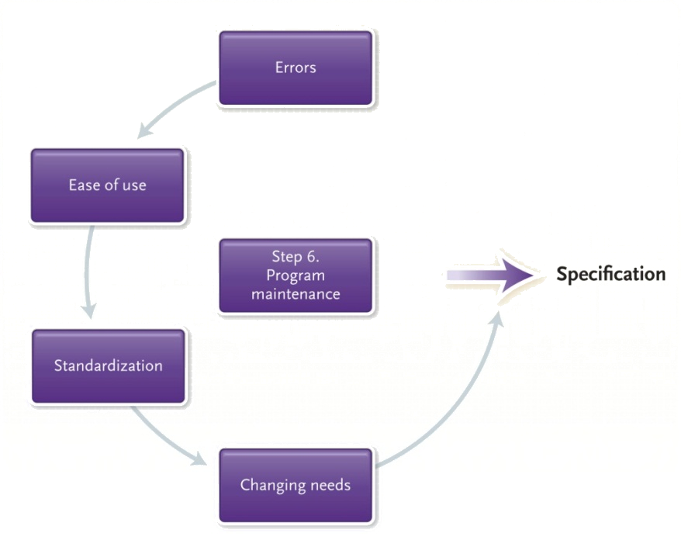
Step 6: Program Maintenance
75% of total lifetime cost
Ensures program is
  Error-free
  Effective
  Efficient
Two activity categories
  Operations
    Patches
    Software updates
  Changing needs
    Agile development
Notes:
As with systems analysis, the program maintenance (key term) takes up the majority of the programmer’s time
This step is critical – to maintain the program and to be sure it is accomplishing what it was intended to accomplish
Operations – Use this part of the process to locate and correct any errors missed previously or that have developed over the life of the program
Programming modifications such as
patches (key term) – program modifications or corrections
software updates (key term) – significant patches
Changing needs – new tax laws, new information needs or new company policy
Agile development (Key Term) is a new development that gets the core functionality of a program working and then expands on it until the client is satisfied

Slide 33
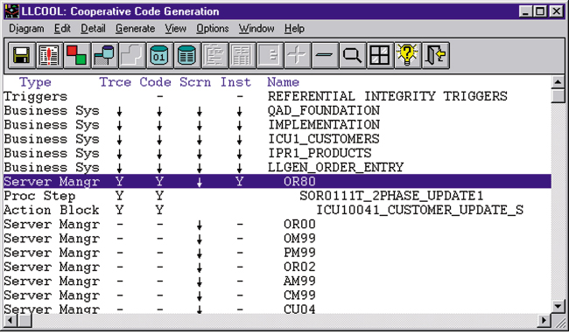
CASE Tools
14-<number>
Computer-aided software engineering
Automate development process
  Designing
  Coding
  Testing activities
Notes:
Two resources that help software development include CASE tools and object-oriented software development
CASE tools help automate the process of designing, coding and testing activities; helps make programmers’ work easier, faster, and more reliable

Slide 34

Object-Oriented Software Development
14-<number>
Focuses less on procedures, more on relationship between objects
OOP: Object-oriented programming
Object contains both the data and the processing operations
Notes:
Traditional systems development is careful , step-by-step approach focusing on procedures to complete certain objective
Object-oriented software development – process by which program is organized into objects
OOP uses modules called objects that are reusable, self-contained components. Presume that certain functions are the same, so instructions are used in variety of software. C++ one of most widely used OOP languages

Slide 35
Generations of Programming Languages
14-<number>
Occurring in “generations”
  Levels
  Machine languages to natural languages
Lower level closer to machine language
Higher level closer to human-like language
Notes:
Writing code means programmer has to learn a language
As we learned earlier, the computer only understands 0s and 1s. Therefore, the most basic of languages is called machine languages where all the instructions are written in a series of 0s and 1s
Needless to say, this makes understanding the instructions very hard for the average person
There is also “natural” languages that more closely simulate the way people actually talk and sort through problems
As computers have gone through generations, so have languages

Slide 36
Generations of Languages
14-<number>
1st -- Machine languages
2nd -- Assembly languages
3rd -- High level procedural languages
4th -- Problem-Oriented Languages
5th -- Natural Languages & Visual programming
Notes:
Machine languages - data represented in 1’s and 0’s; hard to understand; vary according to make of computer!
Assembly languages - abbreviations and mnemonics replace the 0’s and 1’s; easier than machine, but still hard to understand for the common person. Advantage over machine language is that Assembly language is portable from one machine to another.
High level procedural languages: third generation. More closely resembles the way we talk, but still requires considerable training to be able to use and understand. When program written in procedural language, it must be translated into machine language using:
Compiler - converts high-level language (called source code) into machine language (called object code); once done execution faster -- or
Interpreter - converts to machine language just before processing, one statement at a time; easier to develop with
Problem-oriented languages are used for solving specific problems. They generally require little special training on the part of the user.
Query languages - easy commands to retrieve information from databases
Application generators - preprogrammed modules written to perform a specific task
Natural languages are still being developed; these are designed to replicate human languages. Hope is that in near future these languages can be developed to point where they will enable a computer to learn – to remember and improve upon that memory
5GL has been expanded to include visual programming languages that provide intuitive icons, menus, and drawing tools
Example is Microsoft’ Visual Basic

Slide 37
Compiler & Interpreter
14-<number>
?
Compiler
Interpreter

Slide 38
Self-Test
14-<number>
Machine
A. 1111111111000000000000000111111
Assembly
B. ADD 210(8,13), 02B(4,7)
Procedural
C. SELECT client FROM dailyLog WHERE serviceEnd > 17
Problem
D. If ( score >=90 ) grade = ‘-A’;
Natural and
Visual
E. If patient is dizzy, then check temperature and blood pressure

Slide 39

A Look to the Future ~ Your Own Programmable Robot
It may not be to much longer before you have your own robot
Hardware components needed to create are becoming cheaper
Notes:
What if you could have your own robot to do your chores?
It is just a matter of time before these robots can understand human instructions instead of complex programming languages.

Slide 40

FAQs
14-<number>
What is a program?
What is a software engineer?
What is the purpose of pseudocode?
What are the qualities of a good program?
What is the job of a maintenance programmer? Why is it important?
What are CASE tools?
What is object-oriented programming?

Slide 41

Discussion Questions
14-<number>
Discuss the six steps to create a program.
Describe the differences between formatting and programming languages. Give examples of each.
Explain the debugging process for a program.
Why is program documentation important?
Review the five generation levels of programming languages.

Slide 42
Exercise
14-<number>
P.357. Multiple Choice
P.358. Matching
P.358. Open-ended

